Slide 1
高级搜索
Notes:
大家下午好，我们现在开始上课。
我们今天要讲解的内容是，博弈树搜索
上节课，我们对大家刚刚结束的期中课程项目进行了总结

Slide 2
目录
1. 理论课内容回顾
1.1 模拟退火算法
1.2 遗传算法
1.3 Traveling Salesman Problem
2. 实验任务
用模拟退火算法和遗传算法求解TSP

Slide 3
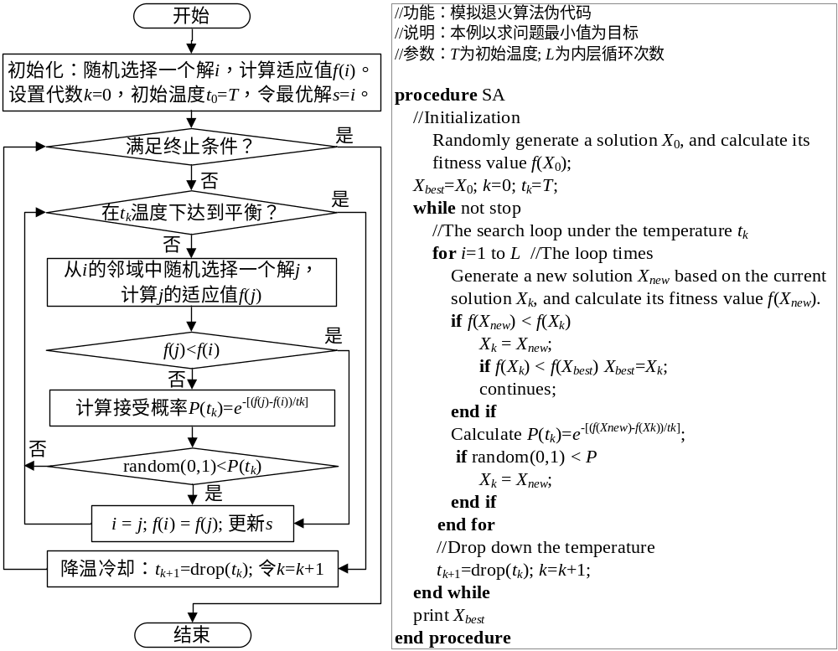
1.1 模拟退火算法

Slide 4
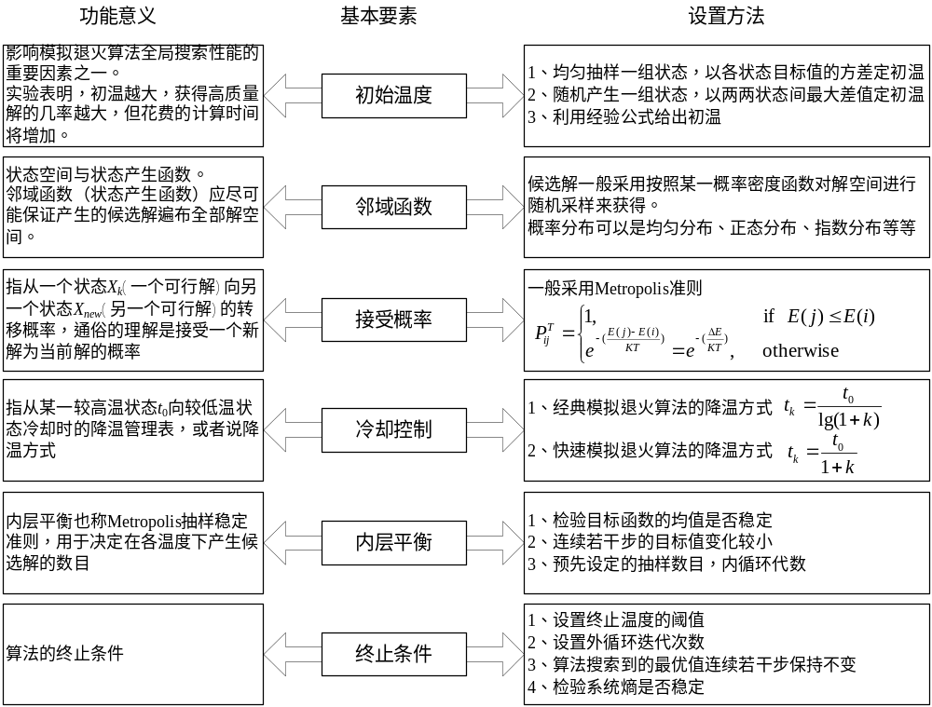
1.1 模拟退火算法

Slide 5
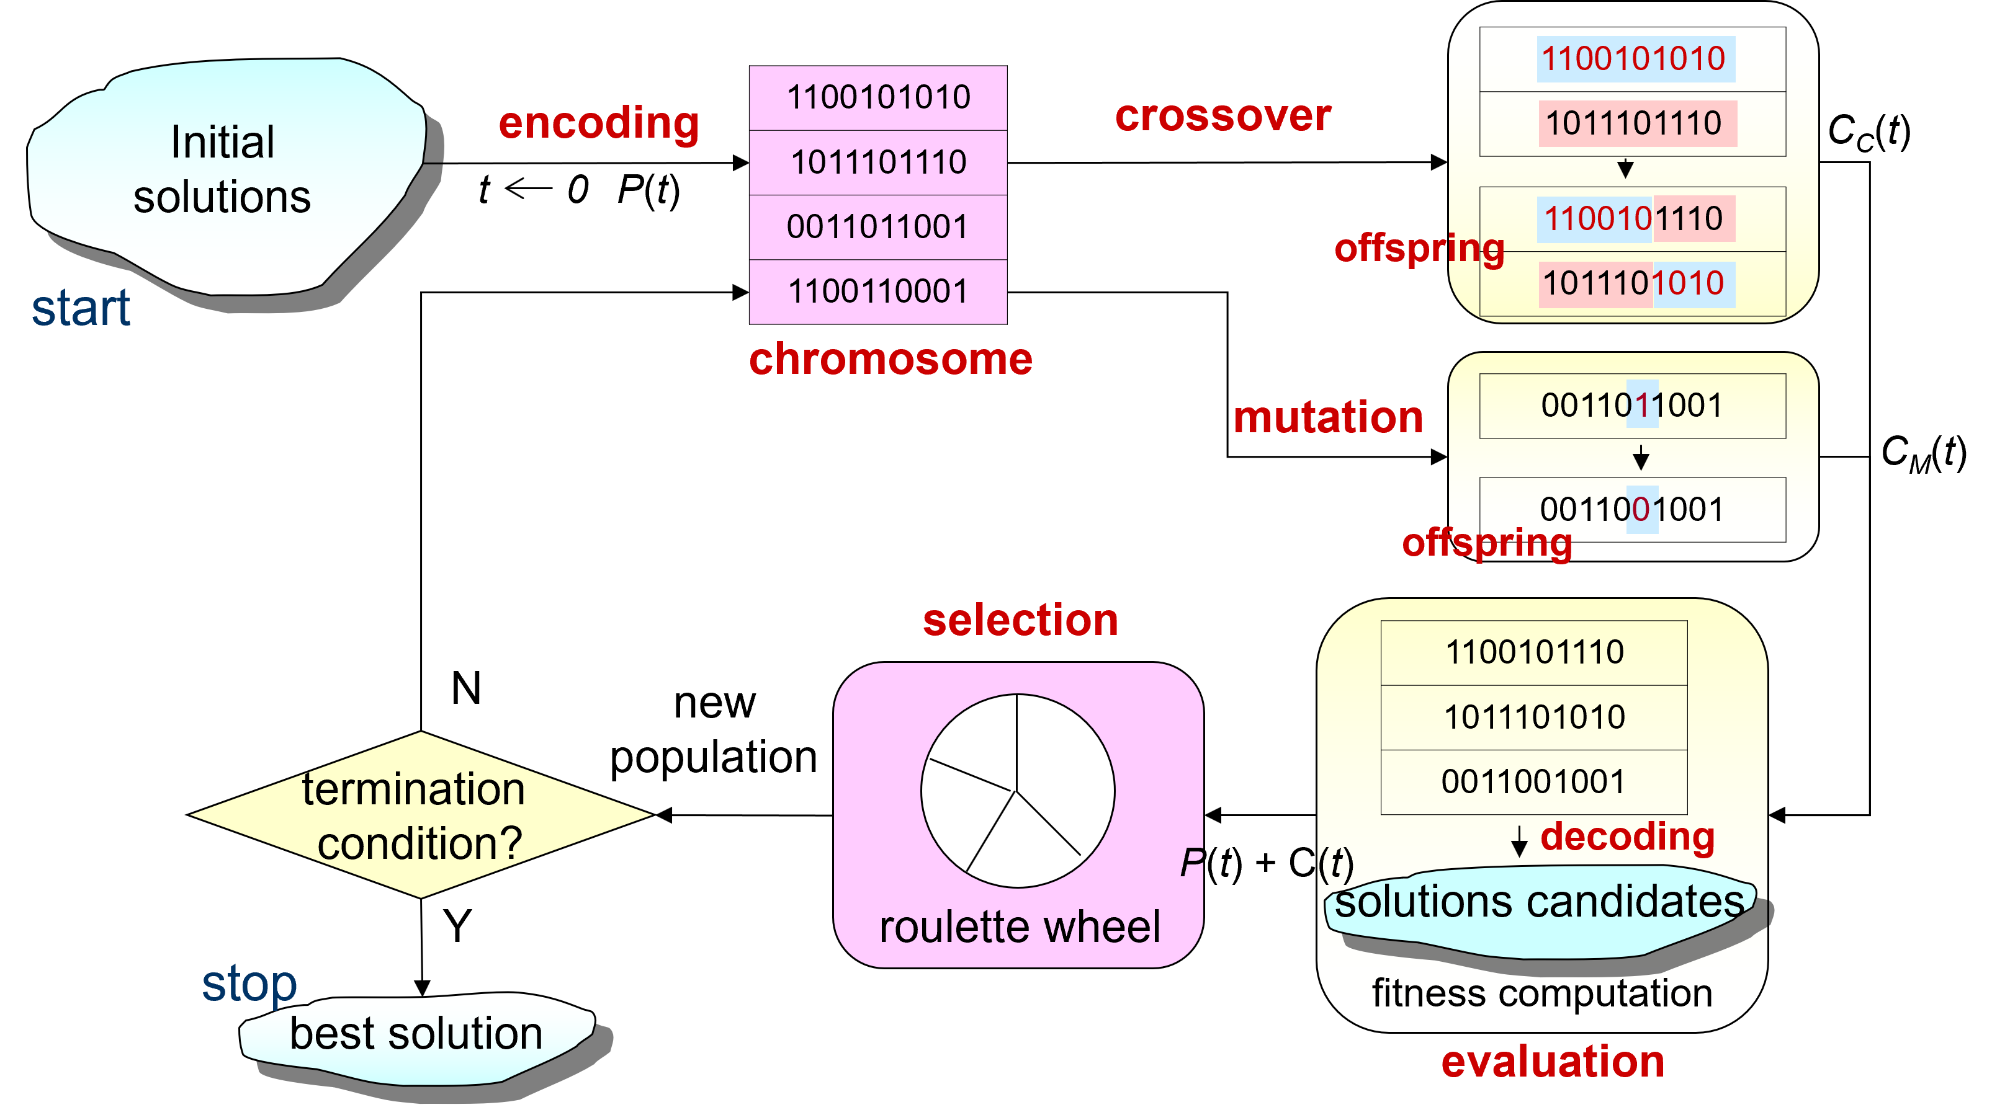
1.2 遗传算法

Slide 6
1.2 遗传算法
procedure: Simple GA
input: GA parameters
output: best solution
begin
t ← 0; // t: generation number
initialize P(t) by encoding routine; // P(t): population of chromosomes
fitness eval(P) by decoding routine;
while (not termination condition) do
crossover P(t) to yield C(t); // C(t): offspring
mutation P(t) to yield C(t);
fitness eval(C) by decoding routine;
select P(t+1) from P(t) and C(t);
t ← t+1;
end
output best solution;
end

Slide 7
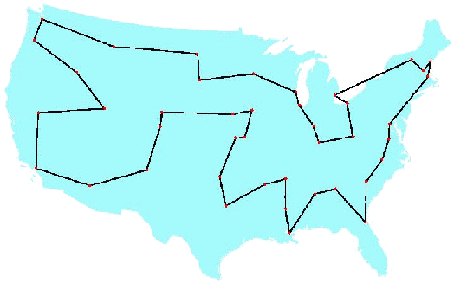
1.3 Traveling Salesman Problem
The Traveling Salesman Problem (TSP) is one of the most widely studied combinatorial optimization problems.
Its statement is deceptively simple: A salesperson seeks the shortest tour through n cities.
Fig. 3.4 George Dantzig, Ray Fulkerson, and Selmer Johnson (1954)
a description of a method for solving the TSP :49 cities

Slide 8
Representation
Random Keys Representation
  This indirect representation encodes a solution with random numbers from (0,1).
  These values are used as sort keys to decode the solution.
  chromosome
where position i in the list represents city i.
tour list 6 - 1 - 3 - 7 - 8 - 4 - 9 - 2 - 5
1 2 3 4 5 6 7 8 9
0.23
0.82
0.45
0.74
0.87
0.11
0.56
0.69
0.78
procedure: Random Keys Encoding
Input: city set,
total number of cities N
output: chromosome v
begin
for i =1 to N
v[i] ← random[0,1];
output chromosome v;
end
procedure: Random Keys Decoding
Input: chromosome v,
total number of cities N
output: tour list L
begin
L← φ;
for i =1 to N
L ← L ∪i;
sort L by v[i];
output tour list L;
end

Slide 9
Crossover Operators
During the past decade, several crossover operators have been proposed for permutation representation, such as partial-mapped crossover (PMX), order crossover (OX), cycle crossover (CX), position-based crossover,
order-based crossover, heuristic crossover, and so on.
These operators can be classified into two classes:
  Canonical approach
    The canonical approach can be viewed as an extension of two-point or multipoint crossover of binary strings to permutation representation.
  Heuristic approach
    The application of heuristics in crossover intends to generate an improved offspring.

Slide 10




Crossover Operators
1. Partial-Mapped Crossover (PMX)
  procedure : PMX crossover
  input : chromosome v₁, v₂,
  length of chromosome l
  output : offspring ,
  begin
  R ← φ;
  // step 1: select two positions
  at random
  s ← random[1:l-1] ;
  t ← random[s+1:l] ;
  // step 2: exchange two substrings
  ← v₁[1:s-1] // v₂[s: t] // v₁[t +1:l] ;
  ← v₂[1:s-1] // v₁[s: t] // v₂[t +1:l] ;
  // step 3: determine the mapping
  relationship
  R ← relation(v₁[s:t] , v₂[s:t]) ;
  // step 4: legalize offspring
  legalize( , , R );
  output offspring , ;
  end
step 1 : select two positions at random
s
t
parent 1
1
2
3
4
5
6
7
8
9
parent 2
5
4
6
9
2
1
7
8
3
step 2: exchange two substrings
proto-child 1
1
2
6
9
2
1
7
8
9
proto-child 2
5
4
3
4
5
6
7
8
3
step 3 : determine the mapping relationship
6
9
2
1
1 6 3
2 5
9 4
3
4
5
6
step 4 : legalize offspring
offspring 1
3
5
6
9
2
1
7
8
4
offspring 2
2
9
3
4
5
6
7
8
1
v₁ : parent chromosome 1 v₂ : parent chromosome 2
l : length of chromosome : offspring chromosome 1
: offspring chromosome 2 R : relationships
s : start position of substring t : end position of substring
relation(v₁,v₂) : searching relationship between v₁ and v₂
legalize(v₁,v₂,R) change genes value of v₁, v₂ based on relationship R

Slide 11


Crossover Operators
2. OX crossover
  procedure : Order Crossover (OX)
  input :chromosome v₁, v₂,
  length of chromosome l
  output : offspring
  begin
  w ←1;
  // step 1: select substring at random
  s ← random[1: l-1] ;
  t ← random[s+1: l] ;
  // step 2: produce a proto-child by
  copying the substring
  ← v₁[s: t] ;
  // step 3: produce offspring by filing
  unfixed positions of proto-
  child from parent 2
  for i=1 to s-1
  for j=w to l
  fg ←0;
  for k=s to t
  if v₂[j] =v₁[k] then
  fg ← 1; break;
  if fg=0 then
  [i] ← v₂[j] ;
  w ←j +1; break;
step 1 : select substring at random
s
t
parent 1
1
2
3
4
5
6
7
8
9
step 2 : produce a proto-child by copying the substring
proto-child
3
4
5
6
step 3 : produce offspring by filing unfixed positions
of proto-child from parent 2
offspring
7
9
3
4
5
6
parent 2
5
7
4
9
1
3
6
2
8
v₁ : parent chromosome 1 v₂ : parent chromosome 2
l : length of chromosome : offspring chromosome
w: working data fg : flag
s : start position of substring t : end position of substring

Slide 12
Crossover Operators
  for i=t+1 to l
  for j=w to l
  fg ←0;
  for k=s to t
  if v₂[j] =v₁[k] then
  fg ← 1; break;
  if fg=0 then
  [i] ← v₂[j] ;
  w ←j +1; break ;
  output offspring ;
  end;
offspring
7
9
3
4
5
6
1
2
8
parent 2
5
7
4
9
1
3
6
2
8
v₁ : parent chromosome 1 v₂ : parent chromosome 2
l : length of chromosome : offspring chromosome
w: working data fg : flag
s : start position of substring t : end position of substring

Slide 13


Crossover Operators
3. Position-based Crossover (PBX)
  procedure : Position-based Crossover
  input : chromosome v₁, v₂,
  length of chromosome l
  output : offspring
  begin
  T ← φ, S ← φ, w ← 1;
  // step 1: select a set of positions
  from parent 1 at random
  N ← random[1:l] ;
  // step 2: produce proto-child by
  copying values of
  selected positions
  for i=1 to N
  j ← random[1:l];
  ← v₁[j] ;
  T ← T∪j ;
  S ← S ∪ v₁[j] ;
step 1 : select a set of positions from parent 1 at random
j
j
j
j
parent 1
1
2
3
4
5
6
7
8
9
step 2 : produce proto-child by copying
values of selected positions
proto-child
2
5
6
9
v₁ : parent chromosome 1 v₂ : parent chromosome 2
l : length of chromosome : offspring chromosome
N : total number of selected positions
T={t[j]} , j=1,2,…, N : selected positions set
S ={s[m]}, m=1,2,…, N : genes value set of selected positions
fg₁ : flag 1 fg₂ : flag 2
w : working data

Slide 14

Crossover Operators
// step 3: produce offspring by filing unfixed
  positions of proto-child from parent 2
  for i=1 to l
  fg₁ ← 0;
  for j =1 to N
  if i=t[j] then fg₁ ← 1;
  if fg₁ =1 then continue;
  for k=w to l
  fg₂ ← 0;
  for m=1 to N
  if v₂[k]=s[m] then
  fg₂ ← 1; break;
  if fg₂ =0 then
  ← v₂[k ];
  w ← k +1 ; break ;
  output offspring ;
  end
step 3 : produce offspring by filing unfixed
  positions of proto-child from parent 2
offspring
4
2
3
1
5
6
7
8
9
parent 2
5
4
6
3
1
9
2
7
8
v₁ : parent chromosome 1 v₂ : parent chromosome 2
l : length of chromosome : offspring chromosome
N : total number of selected positions
T={t[j]} , j=1,2,…, N : selected positions set
S ={s[m]}, m=1,2,…, N : genes value set of selected positions
fg₁ : flag 1 fg₂ : flag 2
w : working data

Slide 15
Crossover Operators
4. Order-Based Crossover (OBX)
procedure : Order-Based Crossover
  input : chromosome v₁, v₂,
  length of chromosome l
  output : offspring
  begin
  S ← φ, T← φ, w ← 1;
  // step 1: select a set of positions
  from parent 1 at random
  N ← random[1:l] ;
  for i=1 to N
  j ← random[1:l];
  S ← S ∪ v₁[j] ;
step 1 : select a set of positions
  from parent 1 at random
j
j
j
j
parent 1
1
2
3
4
5
6
7
8
9
v₁ : parent chromosome 1 v₂ : parent chromosome 2
l : length of chromosome : offspring chromosome
N : total number of selected positions
T={t[j]} , j=1,2,…, N : positions set of assigned genes from v₂ to
S ={s[i]}, i=1,2,…, N : genes value set of selected positions
fg₁ : flag 1 fg₂ : flag 2
w : working data

Slide 16


Crossover Operators
// step 2: produce proto-child by copying
non-selected value from parent 2
  for i=1 to l
  fg₁←0;
  for j=1 to N
  if v₂[i] = s[j] then
  fg₁←1; break;
  if fg₁=0 then
  ← v₂[i],
  T← T ∪i;
  // step 3: produce offspring by copying selected
  values from parent 1
  for i=1 to l
  fg₂←0;
  for j=1 to N
  if i =t[j] then fg₂←1 ;
  if fg₂=1 then continue;
  ← s[w];
  w ← w+1;
  output offspring ;
  end
step 2: produce proto-child by copying non-selected value from parent 2
parent 2
5
4
6
3
1
9
2
7
8
proto-child
4
3
1
7
8
step 3 : produce offspring by copying selected values from parent 1
parent 1
1
2
3
4
5
6
7
8
9
proto-child
2
4
5
3
1
6
9
7
8
v₁ : parent chromosome 1 v₂ : parent chromosome 2
l : length of chromosome : offspring chromosome
N : total number of selected positions
T={t[j]} , j=1,2,…, N: positions set of assigned genes from v₂ to
S ={s[i]}, i=1,2,…, N : genes value set of selected positions
fg₁ : flag 1 fg₂ : flag 2
w : working data

Slide 17

Crossover Operators
5. Cycle Crossover (CX)
  procedure : CX crossover
  input : chromosome v₁, v₂,
  length of chromosome l
  output : offspring
  begin
  S ← φ, T ← φ, w ← 1;
  // step 1: find the cycle between parents
  C ← cy (v₁, v₂);
  // step 2: produce proto-child by copying
  gene values in cycle from parent 1
  for i=1 to l
  for j=1 to N-1
  if v₁[i] =c[j] then
  ← v₁[i] ;
  T ← T∪i ;
  S ← S ∪ v₁[i] ;
step 1 : find the cycle between parents
parent 1
1
2
3
4
5
6
7
8
9
parent 2
5
4
6
9
2
3
7
8
1
cycle 1 5 2 4 9 1
step 2 : produce proto-child by copying gene values
in cycle from parent 1
proto-child
1
2
4
5
9
v₁ : parent chromosome 1 v₂ : parent chromosome 2
l : length of chromosome : offspring chromosome
N : total number of values in cycle
T={t[n]} , n=1,2,…, N-1: positions set of S in proto-child
S ={s[k]}, k=1,2,…, N-1: proto-child genes value set in cycle
C={c[j]}, j=1,2,…, N-1: value set of cycle
fg₁ : flag 1 fg₂ : flag 2
w : working data
cy (v₁,v₂):finding the cycle which is defined
by the corresponding positions between parents

Slide 18
Crossover Operators
  // step 3: produce offspring by filling
  unfixed position from parent 2
  for i=1 to l
  fg₁ ← 0;
  for n=1 to |T|
  if i=t[n] then fg₁ ← 1;
  if fg₁ =1 then continue;
  for j=w to l
  fg₂ ← 0;
  for k=1 to |S|
  if v₂ [j]=s[k] then
  fg₂ ← 1; break;
  if fg₂ =0 then
  ← v₂[j ];
  w ← j +1 ; break;
  output offspring ;
  end
step 3 : produce offspring by filling unfixed position from parent 2
parent 2
5
4
6
9
2
3
7
8
1
offspring
1
2
6
4
5
3
7
8
9
v₁ : parent chromosome 1 v₂ : parent chromosome 2
l : length of chromosome : offspring chromosome
N : total number of values in cycle
T={t[n]} , n=1,2,…, N-1: positions set of S in proto-child
S ={s[k]}, k=1,2,…, N-1: proto-child genes value set in cycle
C={c[j]}, j=1,2,…, N-1: value set of cycle
fg₁ : flag 1 fg₂ : flag 2
w : working data
cycle(v₁,v₂): searching cycle between v₁ and v₂

Slide 19


Crossover Operators
6. Subtour Exchange Crossover
procedure : Subtour Exchange Crossover
  input : chromosome v₁, v₂,
  length of chromosome l
  output : offspring ,
  begin
  S ← φ, T ← φ;
  // step 1: select subtours in parents
  s ← random[1:l-1] ;
  t ← random[s+1:l] ;
  for i=1 to l
  for j=s to t
  if v₂[i]=v₁[j] then
  S ← S ∪ v₂[i];
  else
  ← v₂[i],
  T ← T ∪i;
step 1 : select subtours in parents
s
t
parent 1
1
2
3
4
5
6
7
8
9
parent 2
3
4
9
7
8
5
2
1
6
v₁ : parent chromosome 1 v₂ : parent chromosome 2
l : length of chromosome : offspring chromosome 1
: offspring chromosome 2
N : total number of values in subtour
S ={s[i]}, i=1,2,…, N: value set of subtour
T={t[j]} , j=1,2,…, N: positions set of S
s : stsrt position of substring in v₁ t : end position of substring v₁
fg : flag

Slide 20
Crossover Operators
// step 2: exchange subtours
← v₁[1:s-1] // S // v₁[ t+1:l] ;
  k ← s;
  for i=1 to l
  fg ← 0;
  for j=1 to |T|
  if i=t[j] then fg ← 1;break;
  if fg=1 then continue;
  ← v₁[k] ;
  k ← k+1;
  output offspring , ;
  end
step 2 : exchange subtours
offspring 1
1
2
3
4
7
5
6
8
9
offspring 2
3
4
9
5
8
6
2
1
7
v₁ : parent chromosome 1 v₂ : parent chromosome 2
l : length of chromosome : offspring chromosome 1
: offspring chromosome 2
N : total number of values in subtour
S ={s[i]}, i=1,2,…, N: value set of subtour
T={t[j]} , j=1,2,…, N: positions set of S
s : start position of substring in v₁ t : end position of substring v₁
fg : flag

Slide 21
Mutation Operators
1. Inversion Mutation
  procedure : Inversion Mutation
  input : chromosome v₁, v₂,
  length of chromosome l
  output : offspring
  begin
  // step 1: select subtour at random
  s ← random[1:l-1] ;
  t ← random[s+1:l] ;
  // step 2: produce offspring by
  copying inverse string of
  substring
  S ← invert(v [s: t] ) ;
  ←v [1:s-1] // S // v [ t+1:l] ;
  output offspring ;
  end
step 1: select subtour at random
s
t
parent
1
2
3
4
5
6
7
8
9
step 2 : produce offspring by copying inverse string of substring
offspring
1
2
6
5
4
3
7
8
9
v : parent chromosome l : length of chromosome
: offspring chromosome s : start position of substring
t : end position of substring S : inverse string of substring
invert(string) : inversely changing order of string

Slide 22
Mutation Operators
2. Insertion Mutation
  procedure : Insertion Mutation
  input : chromosome v₁, v₂,
  length of chromosome l
  output : offspring
  begin
  // step 1 : select a position in
  parent 1 at random
  i ← random[1:l] ;
  // step 2: insert selected value in
  randomly selected
  position parent 2
  j ← random[1:l-1] ;
  W ← v [1:i-1] // v[i+1:l] ;
  ← W [1:j-1] // v[i] // W [ j:l-1];
  output offspring ;
  end
step 1 : select a position in parent 1 at random
i
parent
1
2
3
4
5
6
7
8
9
step 2: insert selected value in randomly
selected position of parent 2
j
offspring
1
2
6
3
4
5
7
8
9
v : parent chromosome l : length of chromosome
: offspring chromosome i : selected position in parent 1
j : selected position in parent 2 W : working data set

Slide 23
Mutation Operators
3. Displacement Mutation
procedure : Displacement Mutation
  input : chromosome v₁, v₂,
  length of chromosome l
  output : offspring
  begin
  // step 1: select subtour
  s ← random[1:l-1] ;
  t ← random[s+1:l] ;
  // step 2: insert subtour in a
  random position
  n ← t-(s-1);
  i ← random[1:l-n ] ;
  W ←v [1:s-1] // v [t+1:l];
  ← W [1:i-1] // v [s : t ] // W [ i:l-n] ;
  output offspring ;
  end
step 1 : select subtour
s
t
parent
1
2
3
4
5
6
7
8
9
step 2 : insert subtour in a random position
i
offspring
1
2
5
6
7
3
4
8
9
v : parent chromosome l : length of chromosome
: offspring chromosome s : start position of substring
t : end position of substring n : length of subtour
i : insert position
W : working data set

Slide 24
Mutation Operators
4. Swap Mutation
procedure : Swap Mutation
  input : chromosome v₁, v₂,
  length of chromosome l
  output : offspring
  begin
  // step 1: select two position at random
  i ← random[1:l -1 ] ;
  j ← random[i +1 :l] ;
  // step 2: produce offspring by swapping
  selected positions
  ← v [1: i -1] // v [j] // v [i +1 : j -1]// v [i] // v [j +1 : l];
  output offspring ;
  end
step 1: select two position at random
i
j
parent
1
2
3
4
5
6
7
8
9
step 2 : produce offspring by swapping selected positions
j
i
offspring
1
2
6
4
5
3
7
8
9
v : parent chromosome l : length of chromosome
: offspring chromosome i : selected position
j : selected position

Slide 25
Mutation Operators
5. Heuristic Mutation
  procedure : Heuristic Mutation
  input : chromosome v₁, v₂,
  length of chromosome l
  output : offspring
  begin
  P← φ ;
  // step 1: select positions and
  produce neighbors
  for i=1 to m {
  r ← random[1:l] ;
  P ← P ∪nb(v[r]) ;
  }
  // step 2: produce offspring by
  evaluating neighbors
  w ← F(p[1]);
  for i=2 to |P|
  if w> F(p[i]) then
  w ← F(p[i]), n ← i;
  ← p[n] ;
  output offspring ;
  end;
step 1 : select positions and produce neighbors
r
r
r
F(p[i])
parent
1
2
3
4
5
6
7
8
9
32
proto-child 1
1
2
3
4
5
8
7
6
9
27
proto-child 2
1
2
8
4
5
3
7
6
9
54
proto-child 3
1
2
8
4
5
6
7
3
9
45
proto-child 4
1
2
6
4
5
8
7
3
9
23
proto-child 5
1
2
6
4
5
3
7
8
9
56
step 2 : produce offspring by evaluating neighbors
offspring
1
2
6
4
5
8
7
3
9
v : parent chromosome l : length of chromosome
: offspring chromosome m : total number of selected positions
r : selected position N : total number of neighbor chromosomes
w :working data
n : position of chromosome with best fitness value in P
P{p[i]}, i=1,2,…,N : neighbor chromosome set
nb(v[r]) : searching neighbors of rth gene
F(p[i]) : fitness value of p[i]

Slide 26
Overall Algorithm
GA procedure for Traveling Salesperson Problem
procedure: GA for Traveling Salesperson Problem (TSP)
Input: TSP data set, GA parameters
output: best tour route
begin
t ←0;
initialize P(t) by permutation encoding or random keys encoding;
fitness eval(P) by permutation decoding or random keys decoding;
while (not termination condition) do
crossover P(t) to yield C(t) by partial-mapped crossover;
mutation P(t) to yield C(t) by swap mutation;
fitness eval(C) by permutation decoding or random keys decoding;
select P(t+1) from P(t) and C(t);
t ← t+1;
end
output best tour route;
end

Slide 27
2. 实验任务
在TSPLIB（http://comopt.ifi.uni-heidelberg.de/software/TSPLIB95/，多个地址有备份；其他网站还可以找到有趣的art TSP和national TSP）中选一个大于100个城市数的TSP问题，使用模拟退火和遗传算法求解。
模拟退火：
  采用多种邻域操作的局部搜索local search策略求解；
  在局部搜索策略的基础上，加入模拟退火simulated annealing策略，并比较两者的效果；
  要求求得的解不要超过最优值的10％，并能够提供可视化，观察路径的变化和交叉程度。
遗传算法：
  设计较好的交叉操作，并且引入多种局部搜索操作（可替换通常遗传算法的变异操作）
  和之前的模拟退火算法（采用相同的局部搜索操作）进行比较
  得出设计高效遗传算法的一些经验，并比较单点搜索和多点搜索的优缺点。

Slide 28
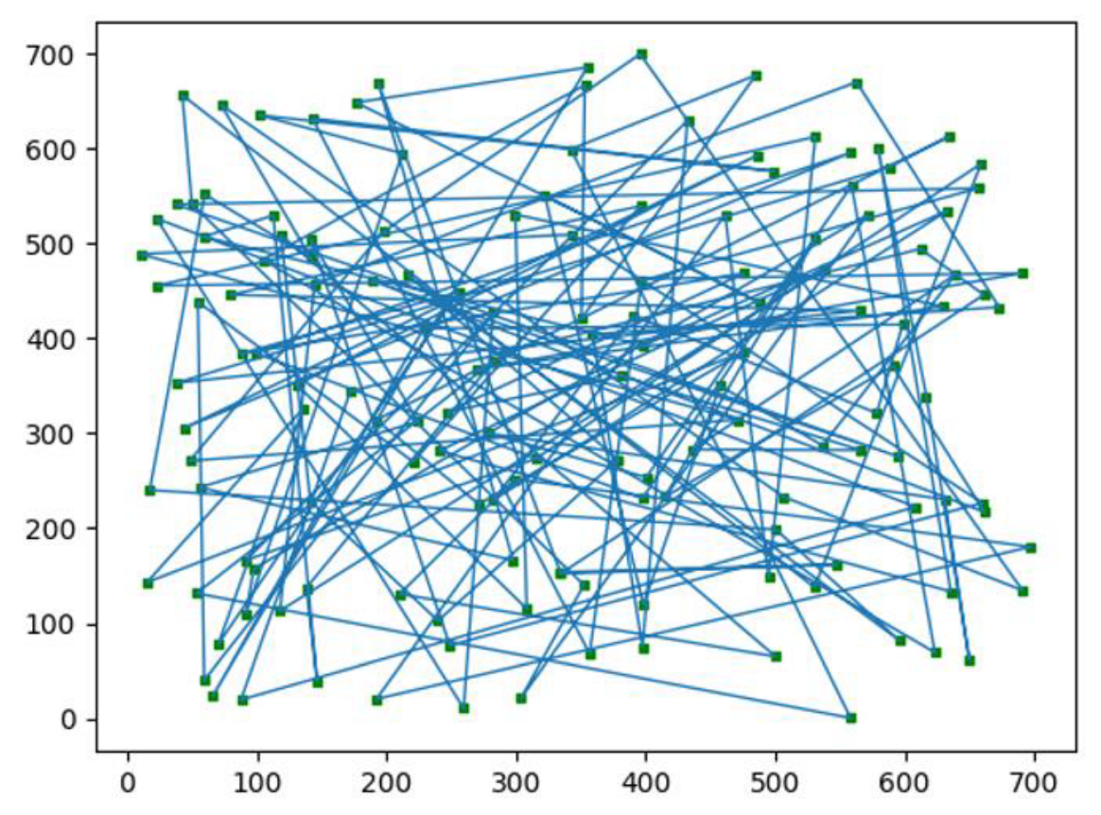
往届学生作品演示
路径可视化
Notes:
是两玩家零和博弈问题

Slide 29
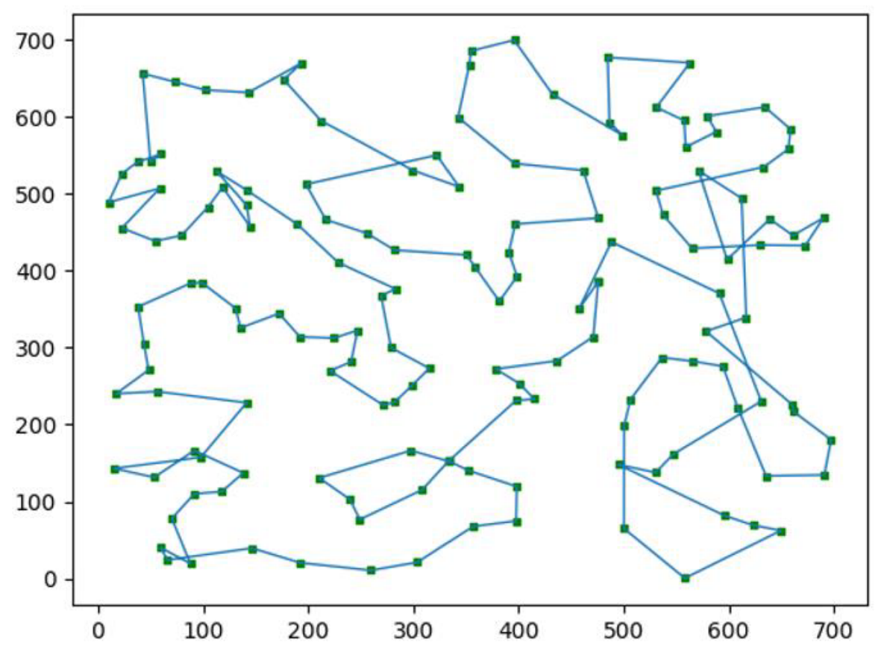
往届学生作品演示
路径可视化
Notes:
是两玩家零和博弈问题

Slide 30
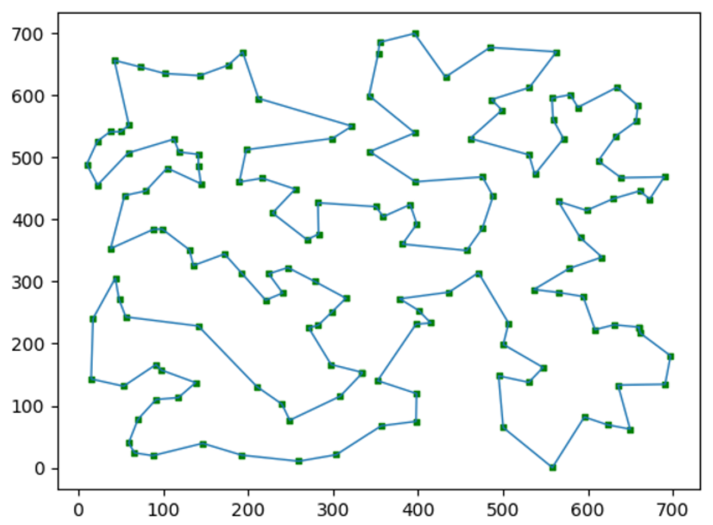
往届学生作品演示
路径可视化
Notes:
是两玩家零和博弈问题

Slide 31
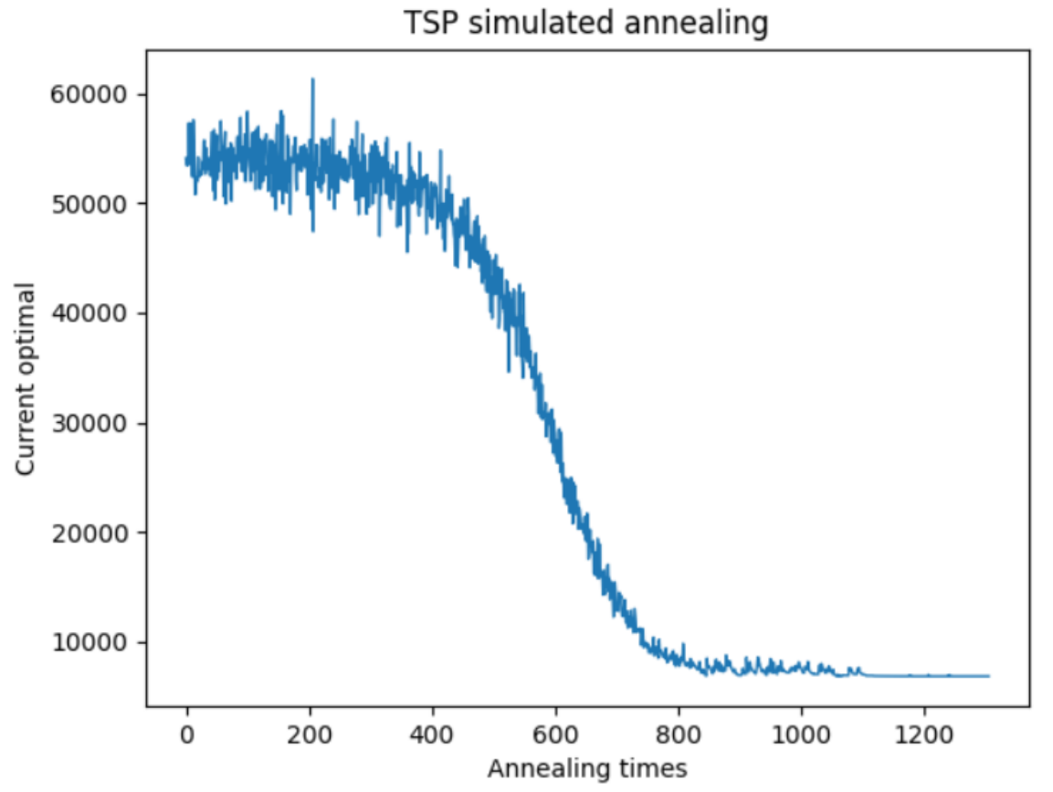
往届学生作品演示
模拟退火收敛曲线
Notes:
是两玩家零和博弈问题

Slide 32
报告提交要求
提交到课程网站（超算习堂）中对应的课程作业，并注意网站上公布的截止日期。
提交格式：提交一个命名为“学号_姓名拼音.zip”的压缩包，压缩文件下包含三部分：code文件夹、result文件夹和实验报告pdf文件。
  实验报告是pdf格式，命名为：学号_姓名拼音.pdf，“学号_姓名拼音”样例：20******_wangxiaoming；
  code文件夹：存放实验代码，一般有多个代码文件的话需要有readme；
  result文件夹：存放上述提到的结果文件；
如果需要更新提交的版本，则在后面加_v1，_v2。如第一版是”学号_姓名拼音.zip”，第二版是”学号_姓名拼音_v1.zip”，依此类推。

